Slide 1
CAD Assembly
Farooq

Slide 2
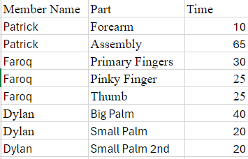
Responsibilities & Time

Slide 3
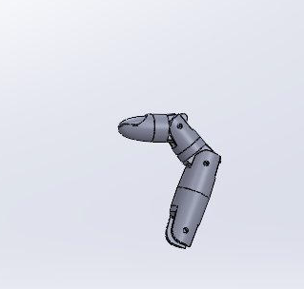
Primary Fingers – (Index, Middle, Ring)

Slide 4
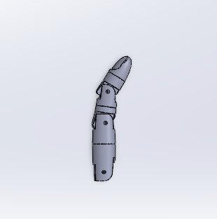
Pinky Finger

Slide 5
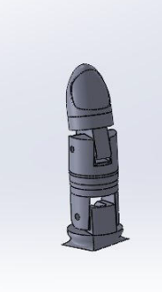
Thumb

Slide 6
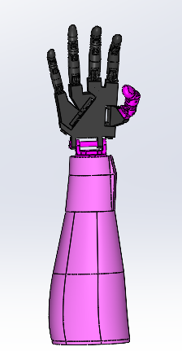
Assembly

